Slide 1


Teloxis Consulting
Your Digital Strategy Partner

Slide 2
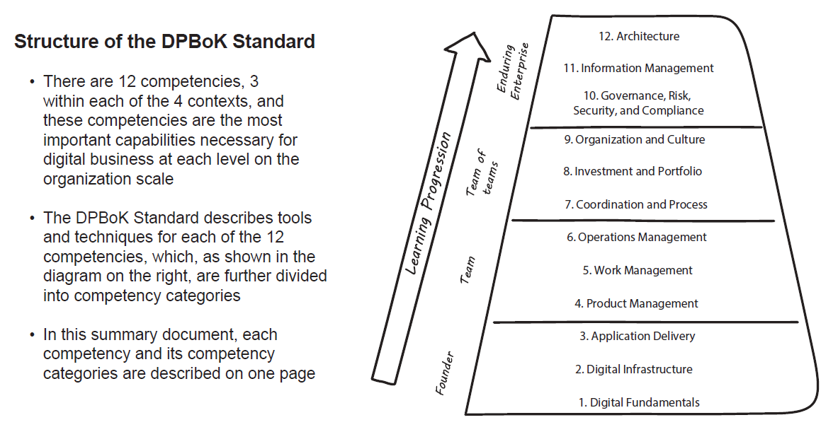
Digital Practitioner Path

Slide 3








Digital Transformation Business Trend
Big Data / Analytics
Sensors & Actuators
Mobile
Technology
Cloud
Computing
Natural User Interfaces
Ubiquitous Connectivity
Technology
Integrated Digital & Physical Experiences
The internet of Everything
Automation of Knowledge Work
Big Data & Advanced Analytics
The Social Matrix
Anything as-a-service
Trends
Leverage
Digital
Improve the Experience
Enhance Productivity
Find New Business Models

Slide 4

How Could I?
Retain Talent
Have an Agile Business
Manage Growth
Drive Innovation
Create new products faster
Have Responsive IT

Slide 5
What Should I?
Adaptive learning, Quick decision making
Digital Organization
Flexible
Inclusive
Innovation
Fluidity
Value Driven
Excellence
Generate measurable business values
Internal collaboration & External Orientation
Embedding technology intelligence in every aspect of business
Test and learn approach
Cross functional teams for ideas incubation

Slide 6
Why Should I?
Best Architecture Principles
Business & IT Alignment
Control Technical Diversity
Standard Methods
Data Management
Interoperability
Security Focus
Business
Perspective
Application
Perspective
Information
Perspective
Technology
Perspective
Conceptual
Level
Business
model
Service
catalogue
Information
model
Technology
platform
Logical
Level
Process
model
Application
architecture
model
Logical data
model
Technical
architecture
model
Operational
Level
Workflow
model
Application
design
model
Physical data
model
Infrastructure
model

Slide 7
Digital Transformation Process Migration
Current Business Growth Requirements and Future Business Augmentation Plans
Taking Stock
Digital Structure
Digital Culture
Technology
Re-engineer Processes
Dynamic Economic, Competitive and Technology Scenario
Internal Capabilities
Digital Opportunities, Process, Technology, Business Model
External Competitive Scenario
Business Environment
Adaptability to innovation & change
Create conditions for Digital Excellence
Cross -functional collaboration
API micro services
Cloud and Mobile
Intrapreneurship mindset
Skill Development
Customer Centricity
Adapt technology to improve performance and deliveries
Digital Analytics in decision making
Digitizing processes
Deliver unified customer experience
Reviewing business models
Strategic Partner Management
Ecosystems
Artificial Intelligence
Digital Devices
Data Security

Slide 8

Digital Transformation Phased Approach
Program
Management
Plan
Governance Model
Business Service Domain Model
SDLC, DevOPS, Processes Methodology Refinement
Composite Applications Orchestration & Choreography
Business Architecture Model
Business Solution Delivery Roadmap
Business Services Design
Business Services Implementation
Project Portfolio Management
Business Process Optimization
Your Current Enterprise
The Agile Enterprise
Information Architecture & Taxonomy
Business Process Model
Enterprise Data Model/ Semantic Model
Metadata Repository Design
Application Platforms, API Management, Micro services
Federated Data Source and Data Services
Technology Services Reference Model
Application Integration Platforms Blueprint
Security Architecture
Network Services Architecture
Network Infrastructure Services
Application Management
Services
Phases
Envision
(Strategy and Plan)
Engineer
(Architect/Design)
Execute
(Develop/Implement)
Work Streams
Program Management
Enterprise Business Services
Information Management
Technology Shared Services

Slide 9
Research & Development Cycle
Consolidate Market and Generate Ideas
Select idea
Find improvements
Research
Personalize Customers
Feasibility
Maintain and Retain
RESEARCH & DEVELOPMENT CYCLE
Develop
Increase Support base
MVP
Increase Client base
Prioritize Features
Launch

Slide 10
Digital Transformation Enablers
Customer
Focus
Strategy
Technology
Culture
Leadership
Technology
Social Integration
Legacy Integration
Analytics
ML / AI
Mobilization
Business
Integration
API
Self-Service
Metrics
Critical Success Factors
Dev OPS

Slide 11
Digital Transformation Skills conversion
Technology
Roles
Virtual Reality
VFX Artist
Computer Vision Engineer
UI/ UX designer, system admin
Information security analyst
Internet of Things
Wireless Network Specialist
Embedded System Programmer
Big Data Analytics
Data Scientist
Data Architect
Artificial Intelligence
AI Research Scientist
Language Processing Specialist
Robotic Process Automation
RPA Developer
Deployment Engineer
3D Printing
3D Modeling Engineer
3D Designer
Cloud Computing
Cloud Architect
Migration Engineer
Social & Mobile
Android/ iOS App developer
Digital Marketing

Slide 12
Digital Transformation Implementation Cycle
User Experience
Product Management
Solution Usability and User readiness
Solution Definition
Solution Delivery
Business Focus
Users
Operations Support
User
Experience
Product
Management
Customer
Test
Program
Management
Project Sponsor
Release Management
Development
Operations
Release / Operations
Solutions Architects
Architecture
Architecture
Technology Focus
Technology Architects
Solution Deployment
Solution Design
Test
Program Management
Development
Solution Validation
Solution Construction / Verification
Solution Delivery Risk Management, Compliance Management

Slide 13
Digital Transformation Product Management
Top management support
Cross-functional team
Clear understanding of customer needs
PERIOD
PROCESS
Culture of innovation
Organized new product development process
PURPOSE
PRODUCT
Teloxis
Product champion with authority
Timely Agile, Lean with DevOPS Automated collaborated development cycle
Value management (costs also add benefits, value)
PEOPLE
PLACE

Slide 14


Digital Transformation Lifecycle
Respond to customer demand
Fast issue resolution
Feedback sets strategy
Safety, Security and Compliance
Pay as you go pricing model
Catalog offerings
Transparent pricing
Create new revenue stream
Plan
Build
Governance
Organize
Prove
Magnify
Inspire
Prepare
Build a Story and Case for Change
Communicate the Need for Change
Build the team
Develop initiatives and Guiding principles
Recruit Champions
Clear the Path
Prove the concept
Evaluate proof of concept
Parallelize activities
Personalize experiences
Generate Increased Momentum
Identify and address resistance
Communicate and Train
Foster Social Collaboration
Introduce peer member ship
Institutionalize the change
Governance
Optimize
Plan
Deploy
Operate
Design
Stabilize
Efficiency
Agility
Implement
Envision
Run
Governance
Build
Plan
Deliver
Governance
Faster time to market
Supports transparency
Value based cost controls
Improve operational efficiencies
Strategy alignment to value
Respond to changing markets
Reduce risk
Improve Consumer experience

Slide 15
Digital Transformation Teloxis Framework
Teloxis Consulting believes in being a partner to make our customers successful. Our edge is about a value based partnership
Inception
Outcome
Discovery
Pain Givers / Gain Getters
Transformation
Pain Relief / Accelerate Growth
RESPOND
PLAN
THINK TANK
Deliver Prototype, Visualize Future, Showcase Features
BUILD
Ideate, Diagnose, Design
Capture Data, Analyse Data, Get Meaningful and Actionable Data
Feedback Loop
Create Services, Automate, Monitor, Interact, Manage Change, Make Provisions, Predict, Prescribe
SENSE BUSINESS
DELIVER
Utilize Domain Knowledge, Technical Knowledge, Process Knowledge, Cultural Knowledge along with Partners and Social Network
Guide Best Practices, Obtain Maximal Efficiency, Higher Effectiveness, Better Customer Experience, Value for money and Stronger Business Growth
KNOWLEDGE MART
RUN
Learn

Slide 16
Digital Product Development Teloxis Framework
Teloxis Consulting believes in being a partner to make our customers successful. Our edge is about a value based partnership
Idea
Sketch
Design
Continuous Development
Continuous Test
Celebrate
To analyze the requirement through in-depth research with the help of brilliant tools.
To draft the design that is related to the research in order to check the feasibility.
After completing feasibility test, a final design is prepared by using smart tools.
Now, our development team starts developing the solution according to design.
In testing phase, we test every component to make sure that our solution fits the requirement.
We make delivery for the solution and assist our clients to control and administer solution.

Slide 17
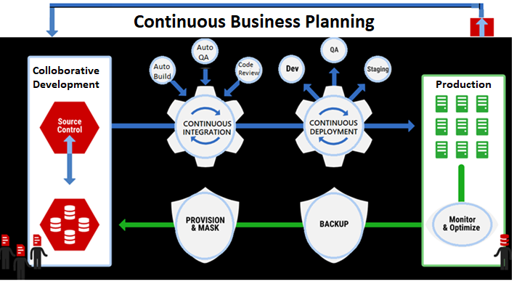
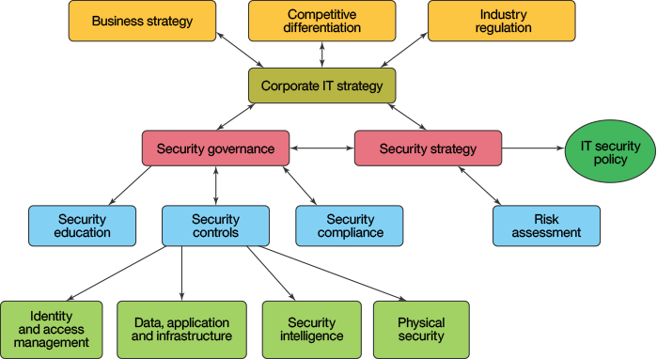
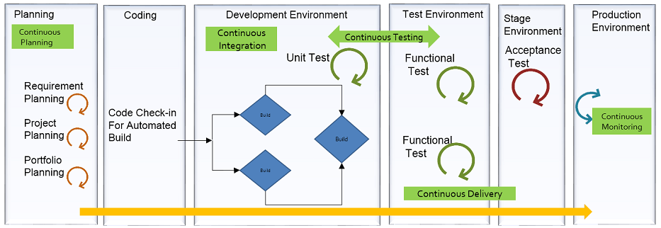
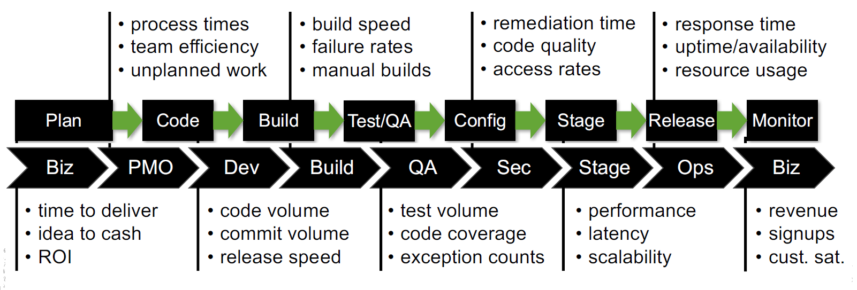
Digital Product DevOps Teloxis Framework

Slide 18
Digital Transformation Enterprise Reference
Business Reference Model
(BRM)
Provides Portfolio
of Services to
Application Reference Model (ARM)
Provides Application Portfolio & S/w Development methods to
Defines methods for
Outcome
Assessment to
Performance Reference Model (PRM)
Digital Enterprise
Data Reference Model
(DRM)
Integration Reference Model (IRM)
Life-cycle Mgt of Enterprise Data of
Interoperability & Integration of
Technology
Reference Model (TRM)
Specifies Technology Landscape & Standards of
Specifies Standards & Best Practices for Security of assets of
Security Reference Model (SRM)
Guides Design &
Implementation of
Architecture Governance Reference Model (GRM)

Slide 19
Digital Transformation Library Reference
Business Strategy
What markets do we compete in and how are we different?
CAPABILITY 1
Business Architecture
What processes support our capabilities?
Process 1
Process 6
Process 12
Application (Services) Architecture
What applications (services) enable our processes?
Service 1
Service 3
Service 6
Service 7
Data Architecture
What data supports our business?
DB 1
DB 12
Infrastructure Architecture
What is the foundation of our business?
Device 2
Device 13
Business
IT
Resource Architecture
What is our optimal resource allocation?
Business
IT
Financial Architecture
What is our optimal investment portfolio?
Expense: $XX
Capital $YY
Development: $XX
Maintenance: $YY

Slide 20
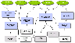
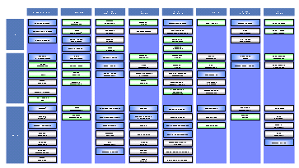
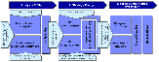

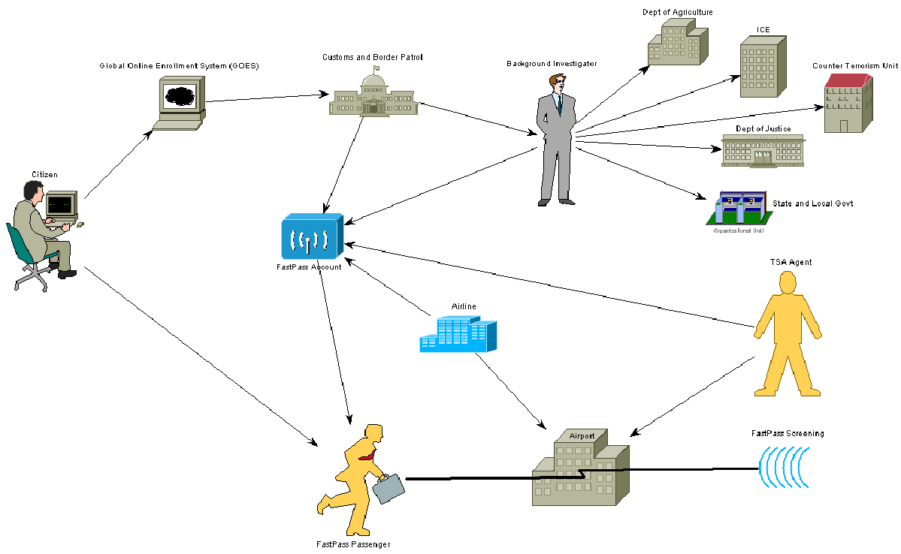

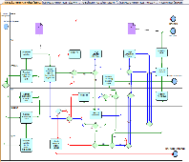

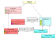

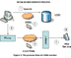
Digital Transformation Architecture Framework
Strategy
Business
Opportunity
Enterprise Strategy
Technology
Availability
ENTERPRISE ARCHITECTURE
Bus Strategy
IT Strategy
Assets that define the enterprise strategy, goals and objectives. What to do, and how to do it?
Planning
Enterprise Architecture
Enterprise wide Focus
Strategy
Enterprise Capabilities
Documentation of organization capabilities, resources, product portfolio, external interfaces, high-level business process blueprint that supports the strategy
Business Architecture
Transition Planning
IS Architecture
Governance
Business
Technology Architecture
Applications and information that support the business and implement the business functions in the IT systems
Information System
Design and
Delivery
Business Operating Environment
and IT Infrastructure
Infrastructure that supports the IS:
Technical components: servers, networks, etc.
Technology: platforms, etc.
Program Focus
Programme Architecture
Solution Outline
Macro Design
Micro Design
Devt, etc.
Programme Architecture
Solution Outline
Macro Design
Micro Design
Devt, etc.
Technology
Change Programs

Slide 21
Digital Transformation Architecture Library
Technology Architecture Continuum
Business Information Models
Information Standards
Technical Architecture
Application Architecture
Customers,
Partners &
Competitors
Foundation
Architectures
Common Systems
Architectures
Industry
Architectures
Organisation
Architectures
Business Models
External Business Environment
Organisational Capabilities
Organisational Memory
Policies, Rules,
Regulations
Vision,
Strategies &
Tactics
Capabilities
Organisation
Information
Roles and Job Descriptions
Skills and Competencies
Management Activities
Culture
Communication
Organisation
Products &
Services
Value
Streams
Initiatives
& Projects
Guides &
Supports
Guides &
Supports
Guides &
Supports
Guides &
Supports
Information
&
Technology
Value Propositions
Value Chains
Core Business Processes
Business Services
Metrics &
Measures
Decisions
& Events
People
Processes
Business Architecture
Products & Services
Systems Solutions
Industry
Solutions
Organisation
Solutions
Solutions Continuum

Slide 22
Digital Transformation IT4IT Library
Enterprise
Defect
Architecture
Component
Service
Component
Archite
-
Defect
cture
Policy
Requirement
Test
Offer Consumption Component
Problem
Incident
Component
Component
Component
Component
Component
Policy
Require
-
Test
Shopping
Problem/
Incident
ment
Case
Cart
Known
Error
Proposal
Source Control
Build
Offer Mgmt.
Request
Chargeback /
Service Level
Event
Component
Component
Component
Component
Request
Rationalization
Showback
Component
Component
Scope
Component
Charge
-
Comp.
Agree
-
Source
Build
Offer
Sub
-
back
Service
Event
ment
scription
Contract
Contract
Portfolio
Project
Build Package
Catalog
Usage
Diagnostics &
Service
Demand
Component
Component
Composition
Component
Remediation
Monitoring
Portfolio
Component
IT
Build
Component
Service
Usage
Run
Component
Service
Comp.
Backlog
Initiative
Package
Catalog
Record
Book
Monitor
Item
Entry
Service
Service
Release
Fulfill
-
Change
Configuration
Portfolio
Design
Composition
ment
RFC
Control
Management
Component
Component
Component
Request
Comp.
Component
Concep
-
Logical
Service
Fulfillment
Desired
Actual
tual
Conceptual
Service
Service
Release
Execution
Service
Service
Service
Release
Comp.
Service
Blueprint
Blueprint
Blueprint
Model
CIs
Strategy to
Requirement to Deploy
Request to Fulfill
Detect to Correct
Portfolio

Slide 23
Digital Transformation Outcome
Reimagine
Design
Transform
Organization wide deployment of digital enterprise and application
Digitization needs new skills and processes
Automate Dynamic of Change
Innovation
Digitize the way of working
Cloud
Data Analytics
Mobile
Social Media
IoT
Innovation needs design thinking leadership
Automation needs new capabilities
Changes
Market Results
Customer Satisfaction
Organization Culture
Business Initiatives
Digital Dream Zone
Business Model Design
Market Results
Digital Transform
Digital Strategy
Enterprise Architecture
Digital Experience
Value Generation
Value Proposition
Value Governance
Value Efficiency
Customers and Consumers Centricity
Increase Efficiency
1
2
3
Accelerate Execution
Automate Process Steps
Digital out tasks
Digital Foundation
People and Skills
Processes
Culture
Structure & Governance
Business Models & Offerings
Leadership & Strategy
Doing things right
Increase Effectiveness
4
5
6
Speedup to signal action
Delayer Processes
Raise Process Intelligence
Doing the right thing
Increase Agility
7
8
9
Increase Flexibility
Fasten the Feedback
Brainstorm Innovation
Speed of adoption

Slide 24
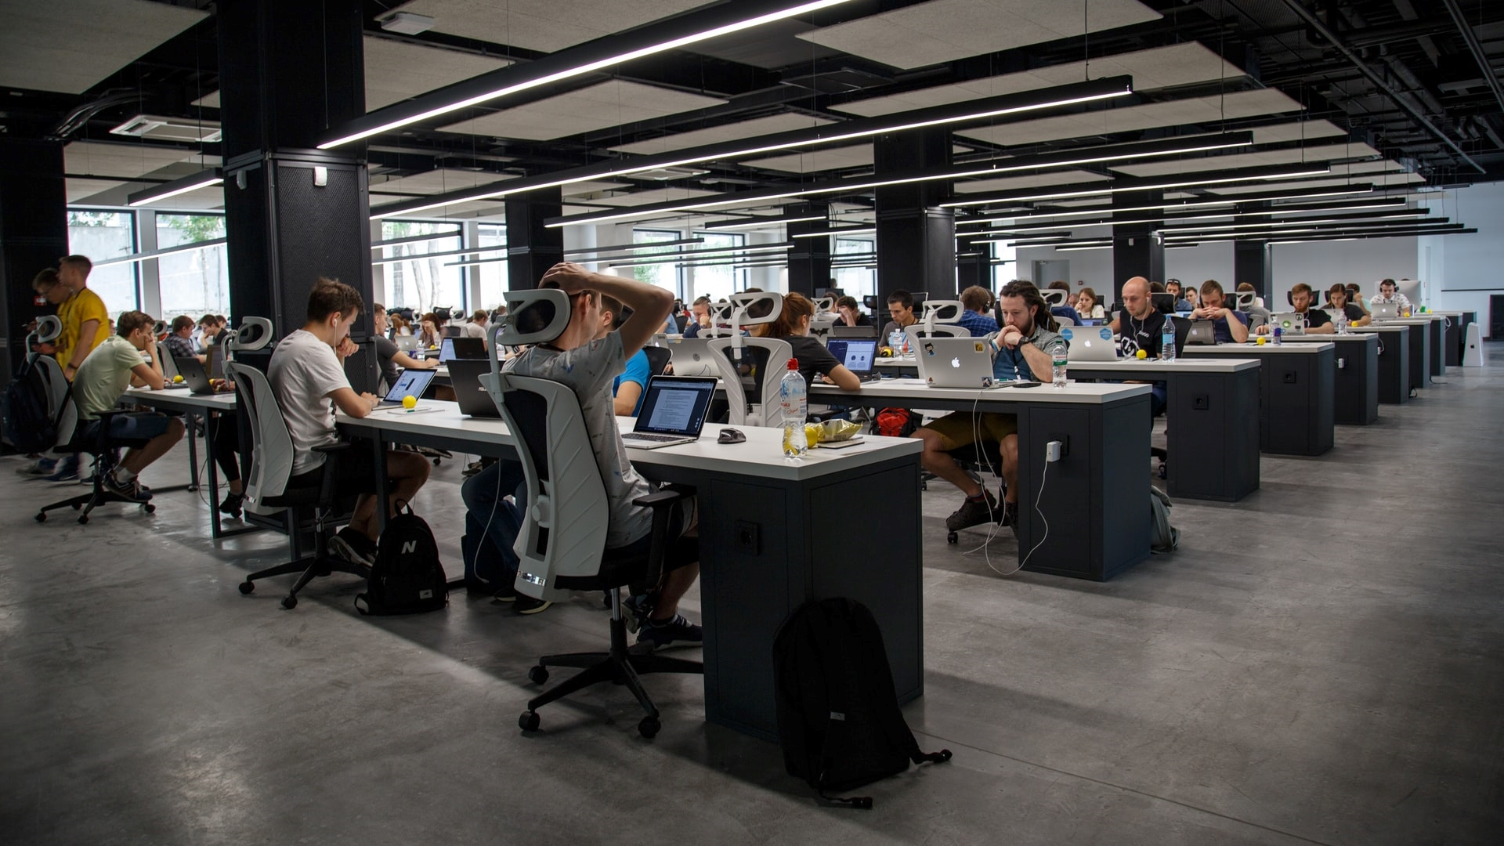
Thank
You
info@teloxis.com

